Slide 1

Predicting the Next Blockbuster
Box Office
Smash
Victoria Anorve, Joel Pepera, Benya Piyathamsoontorn, Radha Yadavilli, & Dan Zhou

Slide 2
Presentation agenda
Project Background
Data Source Summary
Data Wrangling and Storage
Feature Generation
Exploratory Data Analysis
Data Modeling and Analysis
Final Model Performance Comparison
Real-time APP prediction Demonstration

Slide 3
Project Background
Film industry is a lucrative sector
Our objective: analyze the features and characteristics that make a movie successful
To predict how a particular movie will gross in sales, we will analyze previous performance of movies and develop a model to forecast a movie’s revenue.
Notes:
1st paragraph notes:
-While some movies generate billions of dollars in box office sales, other lack in viewership and profit
-Film industry provides accessibility and affordable entertainment to viewers
-Determining which factors contribute to the success of a movie is important to its investors and industry

Slide 4
Questions and Hypothesis
Question: How much revenue will a particular movie gross in sales?
How much variation is there in box office performance by movie?
What attributes about the movie show the strongest correlation to sales?
What level of prediction accuracy is possible with the data we have?
Hypothesis: Using information available before its release, we can significantly improve upon baseline predictions.
Comparable projects found online using linear models, as well as a basic model we trained on budget & release year/week provide baseline
R^2 ~ 0.44 – 0.46

Slide 5
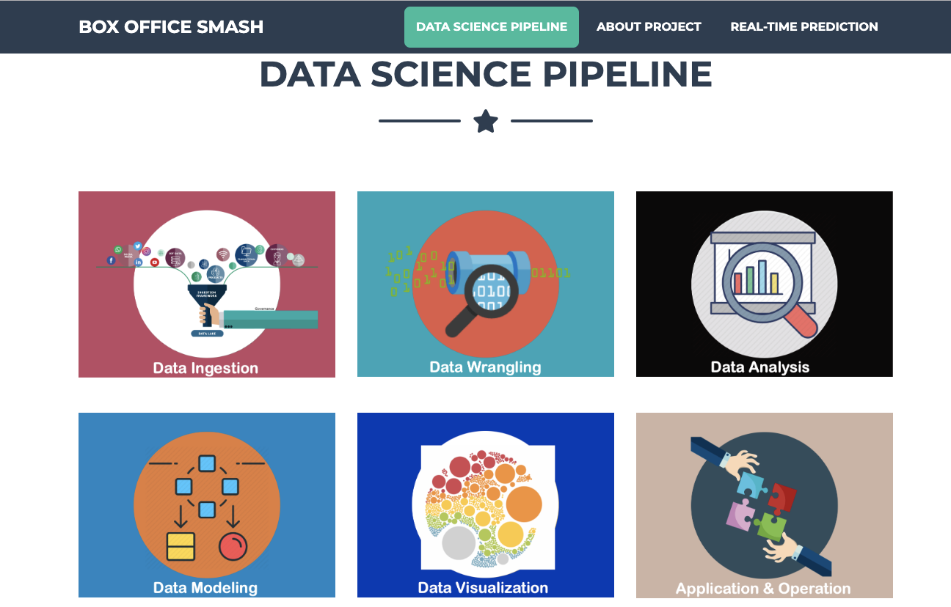
Notes:
-Can we make each of the data science pipelines bigger? It is hard to see which data ingestion

Slide 6







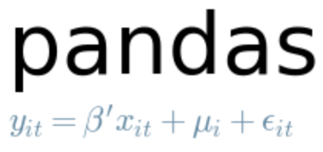





Box Office Smash Architecture Diagram
GitHub
SQL
Data Ingestion
AWS RDS
AWS EC2
Data Wrangling
Data Storage
v
Exploratory Analysis
PostGreSQL DB
Machine Learning
psycopg2
Input Data
boxofficemojo
Input Data
the-numbers.com
imdb.com

Slide 7



Data Sources
Notes:
-Mention that

Slide 8
Available Data
Limited dataset to movies released after 1999 to ensure relevance of actor information and other indicators. Final dataset: 2,788 rows.
Domestic Gross Box Office Sales (target)
Release Date
Production Budget
Movie Rating
Studio
Movie Runtime
Genres
Keyword Descriptions
Directors
Writers
Composers
Actors/Actress

Slide 9
Project Criteria
10 years worth of data
Box office revenue is from domestic revenue
Revenue only from movies released in theaters
No non-theater revenue such as DVD sales were included
Notes:
Which years did we include?
Movies in the theaters
Box office revenue are domestic sales not worldwide revenue
No DVD or non-theater revenue (such as DVD) were included
Language in English

Slide 10
Data Ingestion
Data Ingestion
AWS RDS
AWS Relational Database Storage(RDS) :
Shared database for collaborative purposes
Data Storage
PostGreSQL DB
Store as raw html
PostgreSQL :
Storage capacity & wrangling flexibility
Input Data
boxofficemojo
Input Data
the-numbers.com
imdb.com

Slide 11
Data Wrangling
ETL
Ingest data from web scraper
Use beautiful soup to wrangle the data then insert into Postgres DB
Data Assembly
Join data from 3 sources & several IMDB tables using entity resolution (slugify title for fuzzy matching) [SQL]
Data Ingestion
AWS RDS
Data Storage
PostGreSQL DB
Store as raw html
Input Data
boxofficemojo
Input Data
the-numbers.com
imdb.com

Slide 12
Feature Engineering
Assigned labels to each classification
Release Date → Release Year & Release Week
Production Budget → Scaled to [0, 1]
Movie Rating → One-Hot Encoded
Studio → One-Hot Encoded (Top 6 Only)
Movie Runtime → Scaled to [0, 1]
Genres → One-Hot Encoded (Top 15 Only)
Keyword Descriptions → One-Hot Encoded (Most Frequent)
Directors → One-Hot Encoded (Top 14 Only)
Writers → Dropped
Composers → Dropped
Actors/Actress → One-Hot Encoded (Top 41 Only) + indicator for lead gender
(challenging many to one relationship w/ different roles (lead, support, etc. by movie)

Slide 13
Exploratory Analysis

Slide 14
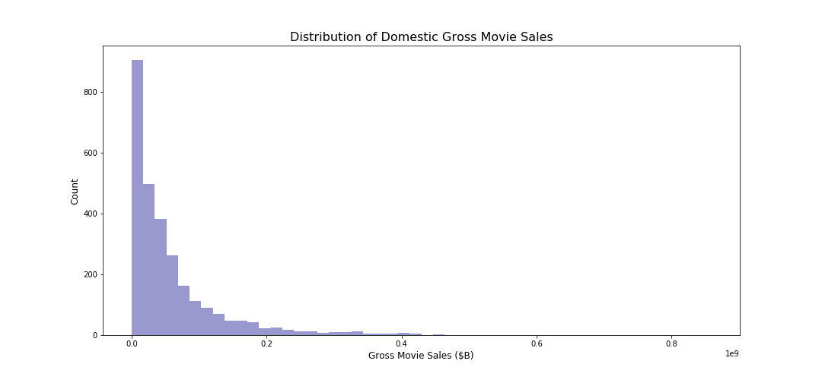
Target Variable – Gross Domestic Sales

Slide 15
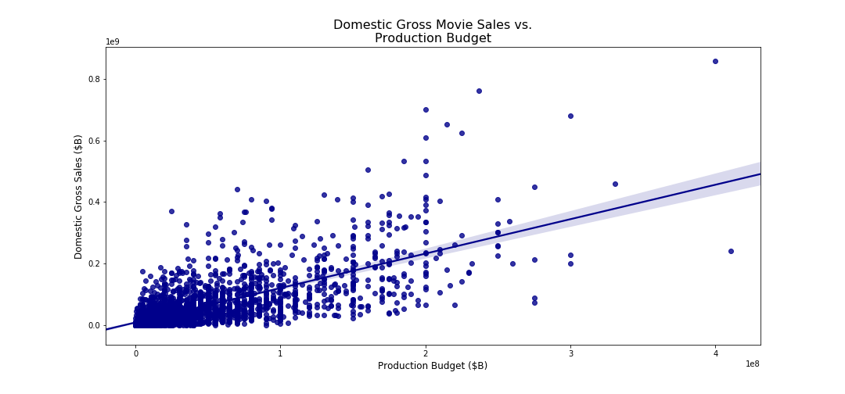
Sales vs. Budget

Slide 16
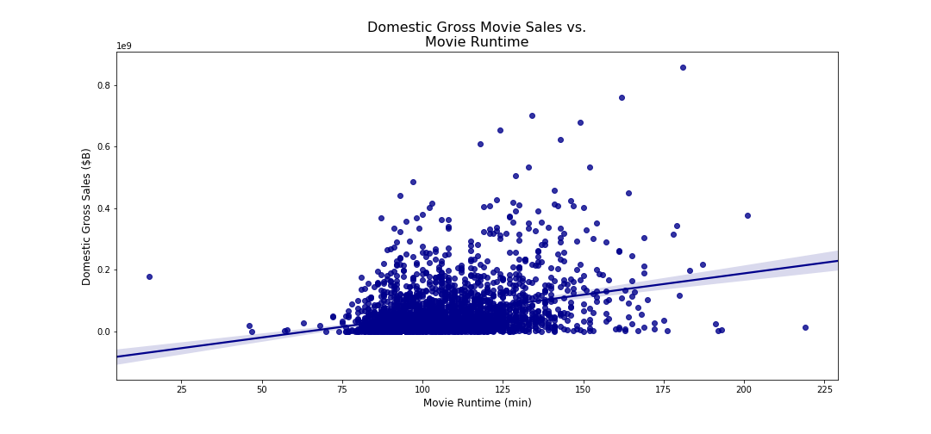
Sales vs. Runtime

Slide 17
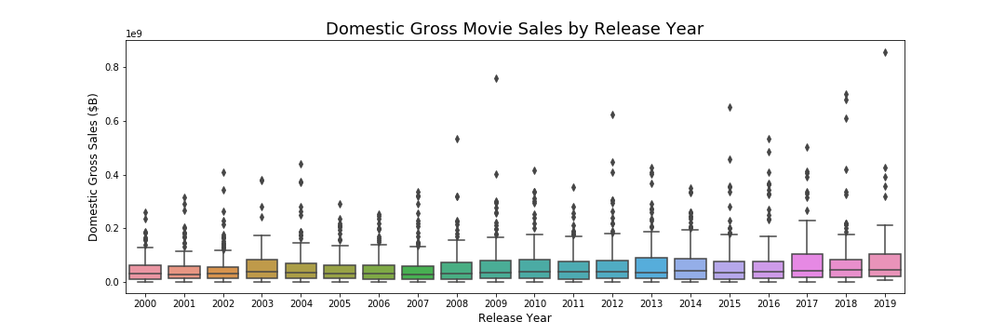
Sales by Year

Slide 18
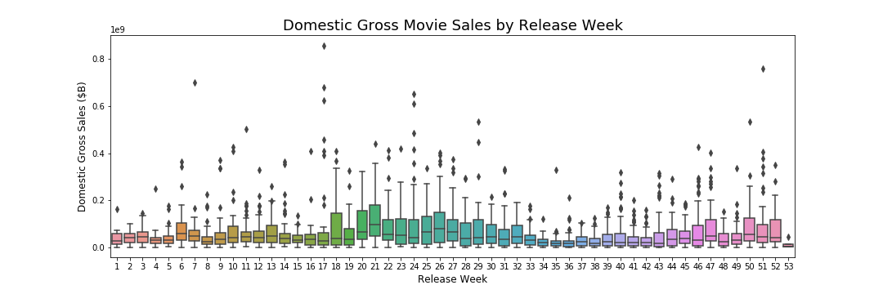
Sales by Week of Release

Slide 19
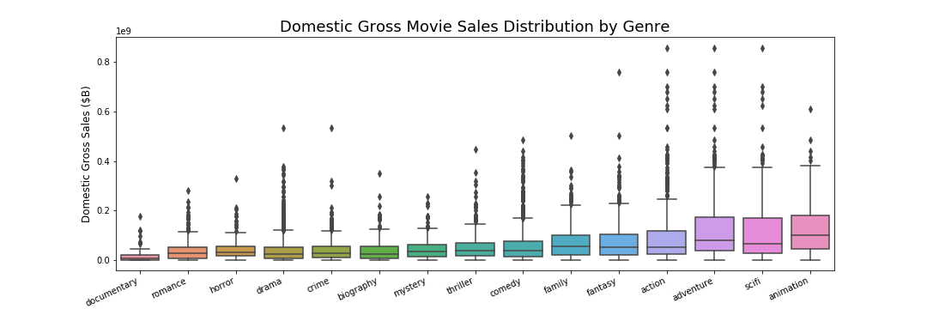
Sales by Genre

Slide 20
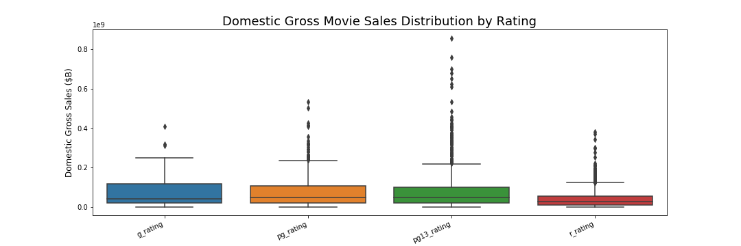
Sales by Rating

Slide 21
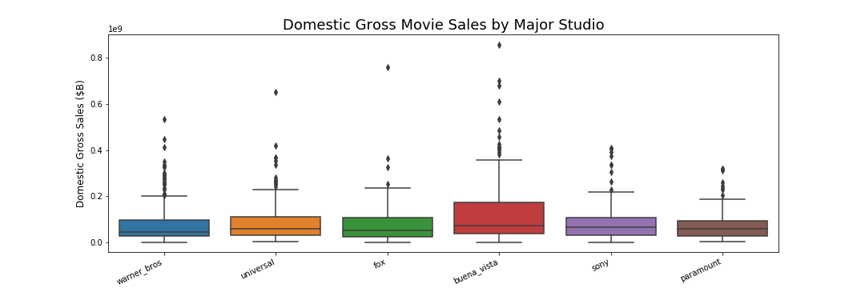
Sales by Studio

Slide 22
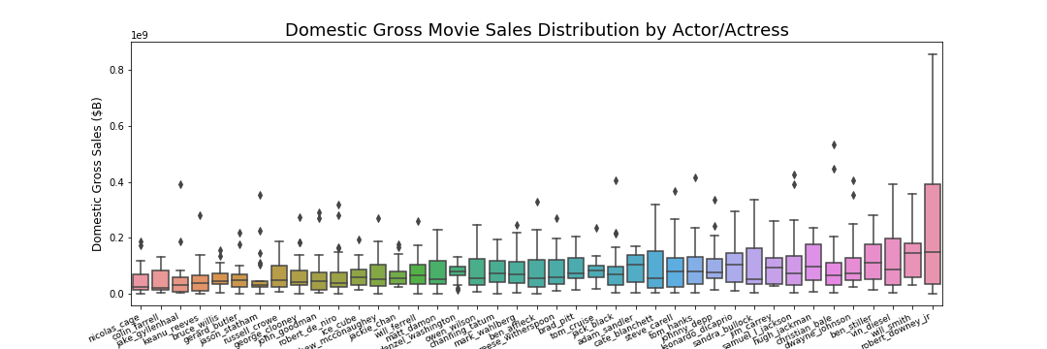
Sales by Actor/Actress

Slide 23
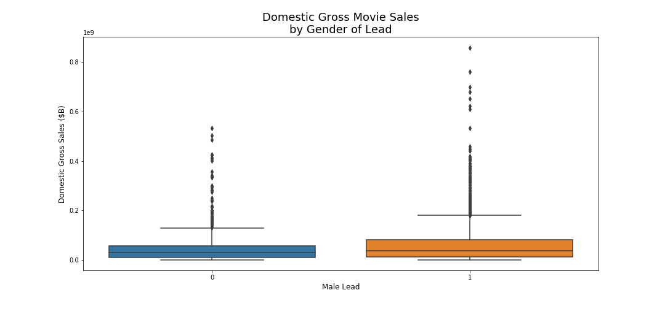
Sales by Gender of Lead

Slide 24
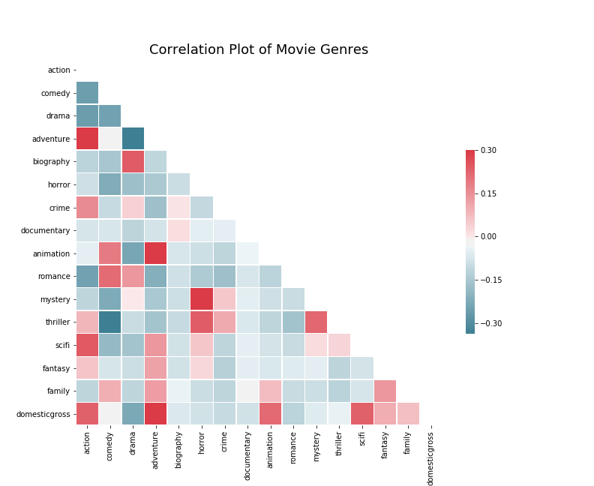
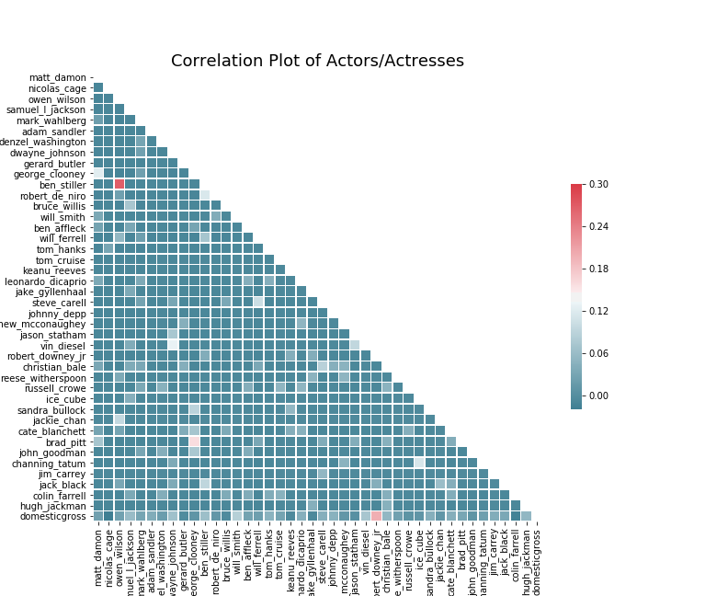
Genre & Actor Correlation
Note: Attempts to reduce genre dimensionality (PCA, Kmeans, AgglomerativeClustering, DBScan) failed to improve model performance
Notes:
-Dimensionality reduction failed to improve model performance possibly because there were too many missing values
-With certain features, such as genre, the model slightly improved when reducing the number of observations based off of examining the significance level for each genre in a OLS model

Slide 25
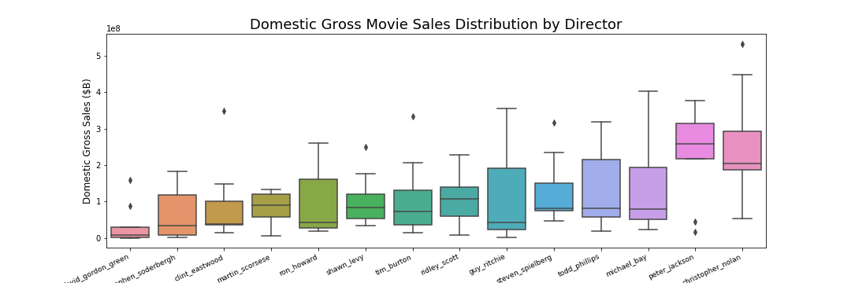
Sales by Director

Slide 26
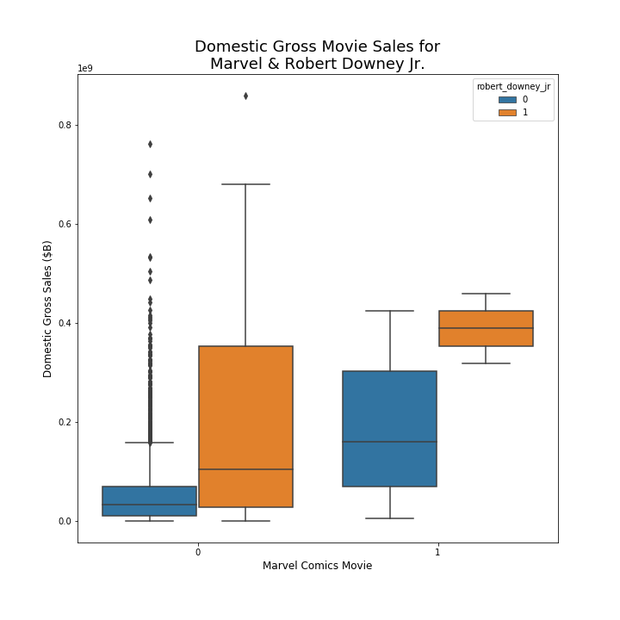
Marvel Comics or Robert Downey, Jr?

Slide 27
Trends over Time

Slide 28
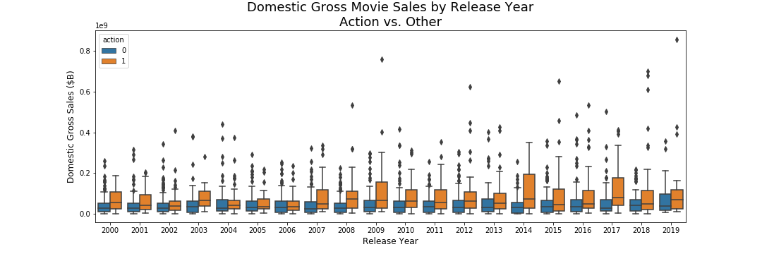
Strong Decade for Action

Slide 29
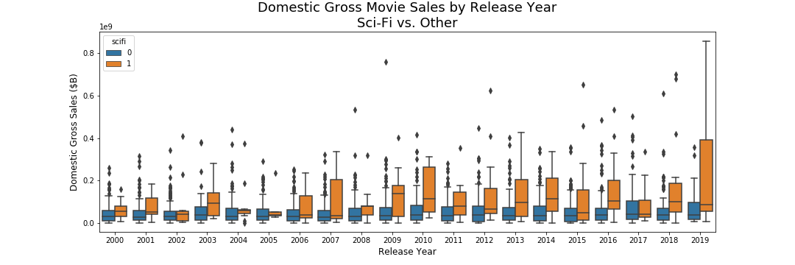
…and Sci-Fi

Slide 30
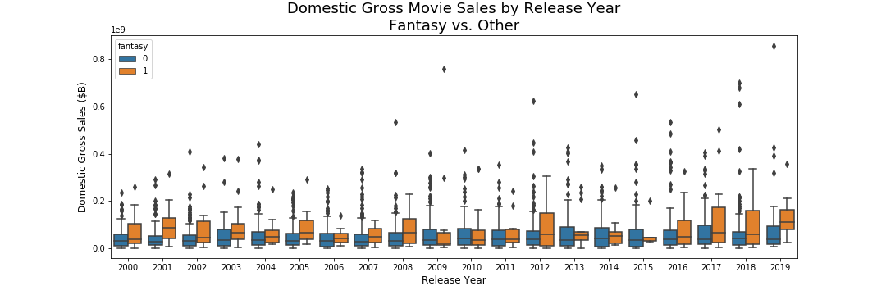
Fantasy Emerging?

Slide 31
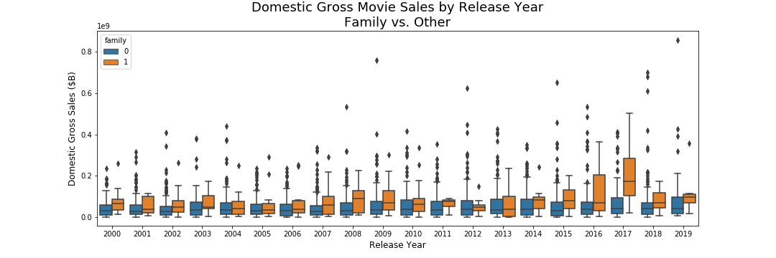
A Couple Good Years for Family Films

Slide 32
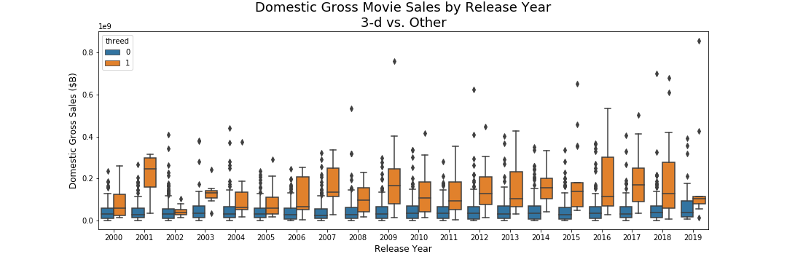
3-D Consistently Strong

Slide 33
Model Training, Selection, & Analysis

Slide 34
Pipeline Construction
SimpleImputer (median)
Numeric
MinMaxScaler
Column Transformer
Regressor
Categorical
SimpleImputer (0)

Slide 35
Model Selection
Initial Experimentation
Hyperparameter Tuning
Selection & Final Tuning
Gradient Boosting Regressor
Multi-Layer Perceptron
Gradient Boosting Regressor
Nearest Neighbors Regessor
Bayesian Ridge
Elastic Net Regression
Gradient Boosting Regressor
Linear Regression
Lasso Lars
Elastic Net Regression
Random Forest Regressor
Lasso Lars
Random Forest Regressor

Slide 36
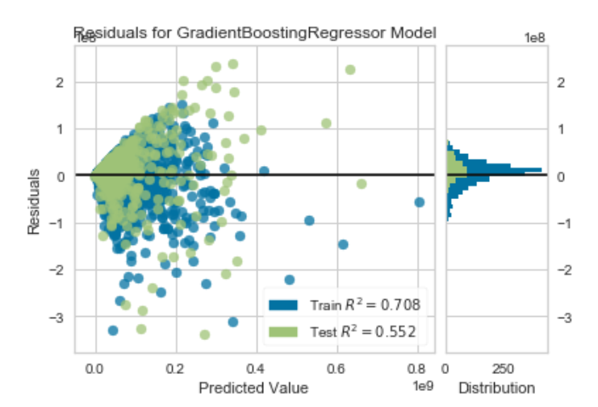
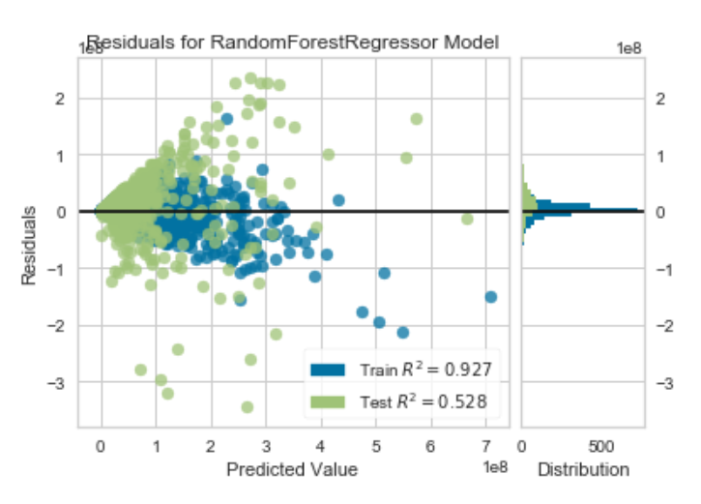
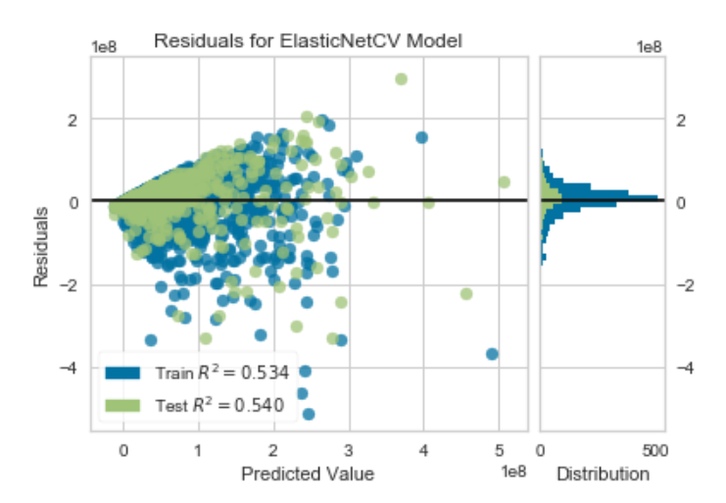
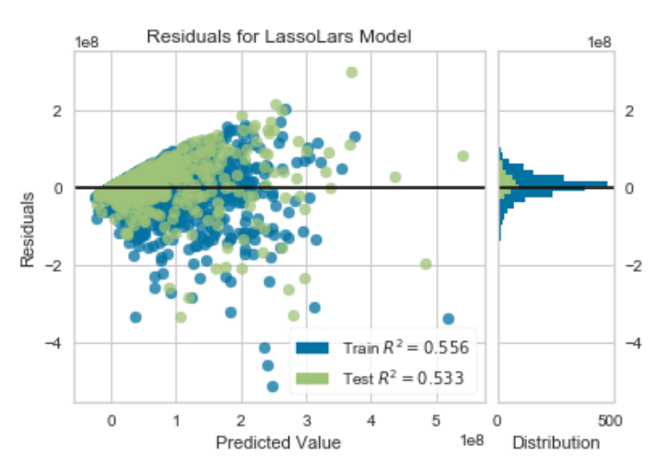
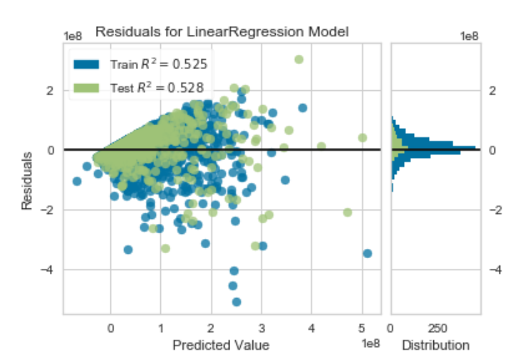
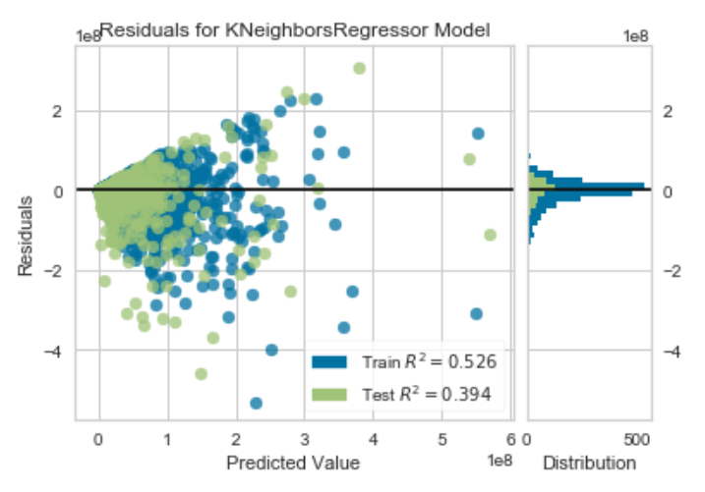
Performance Comparison

Slide 37
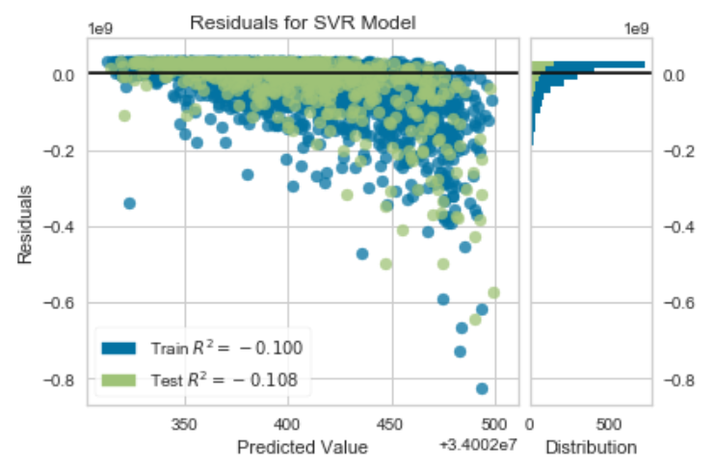
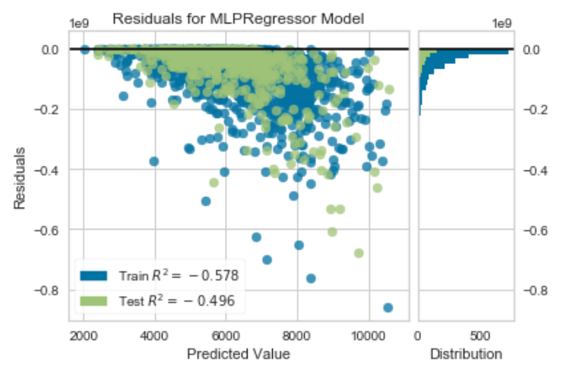
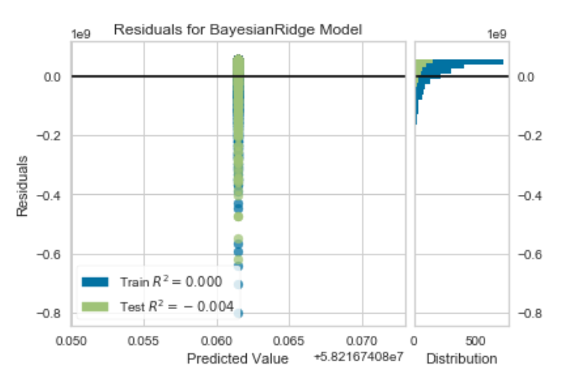
Performance Comparison

Slide 38
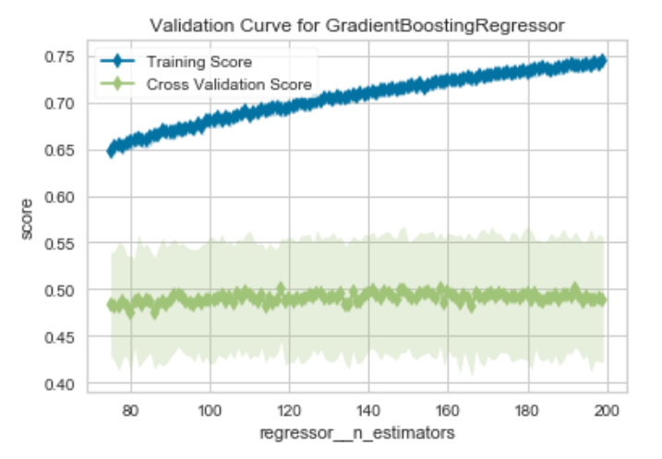
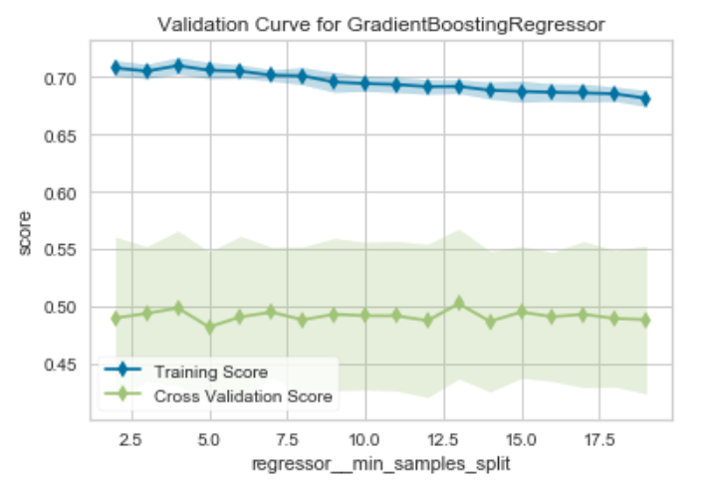
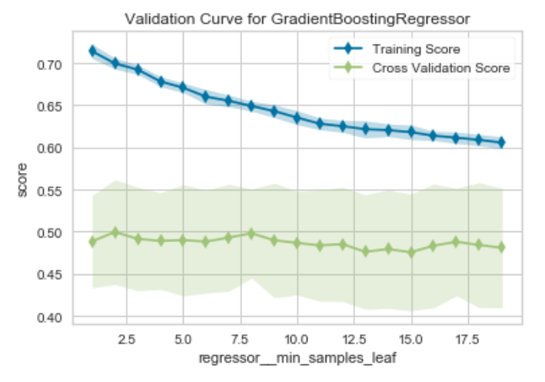
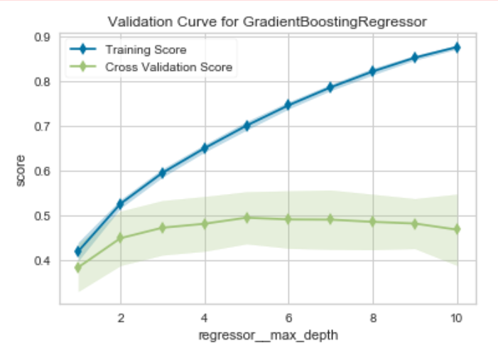
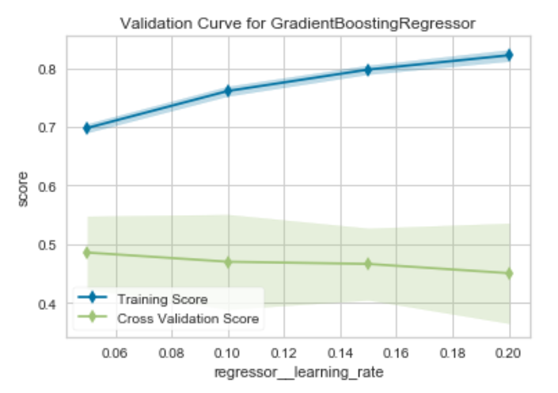
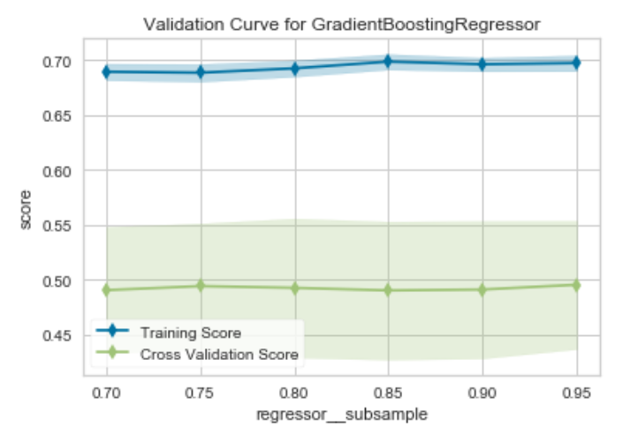
Hyperparameter Tuning - GBM

Slide 39
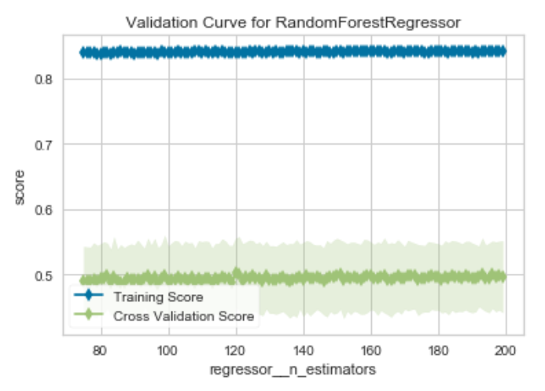
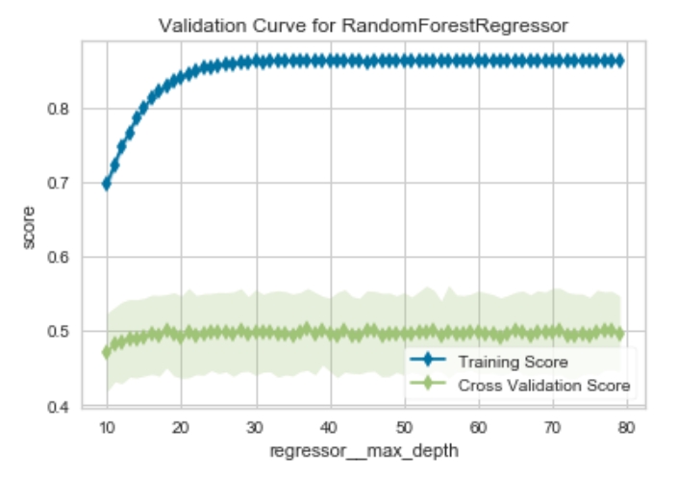
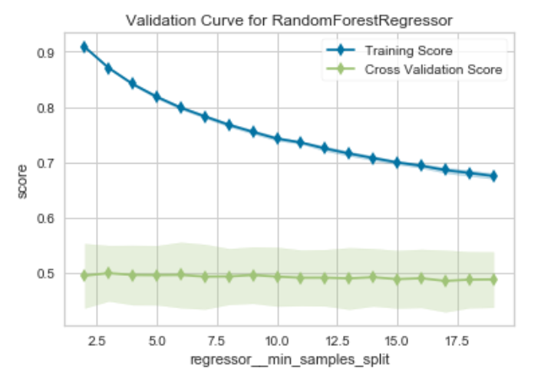
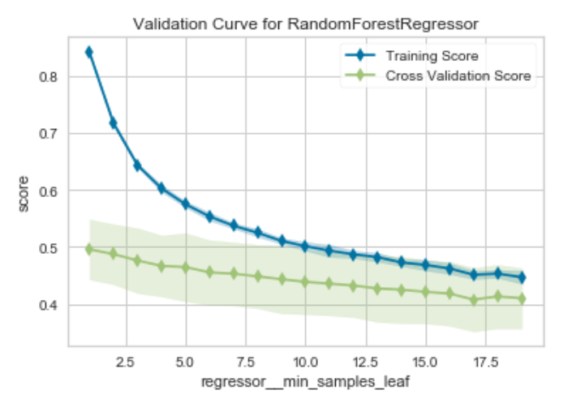
Hyperparameter Tuning – Random Forest

Slide 40
Final Models - RandomizedSearchCV
Model
R^2
GradientBoostingRegressor(alpha=0.9, ccp_alpha=0.0, criterion='friedman_mse', init=None, learning_rate=0.05, loss='ls', max_depth=5, max_features='sqrt', max_leaf_nodes=None, min_impurity_decrease=0.0, min_impurity_split=None, min_samples_leaf=2, min_samples_split=8, min_weight_fraction_leaf=0.0, n_estimators=125, n_iter_no_change=None, presort='deprecated', random_state=None, subsample=1, tol=0.0001, validation_fraction=0.1, verbose=0, warm_start=False)
.586
RandomForestRegressor(bootstrap=True, ccp_alpha=0.0, criterion='mse', max_depth=20, max_features='sqrt', max_leaf_nodes=None, max_samples=None, min_impurity_decrease=0.0, min_impurity_split=None, min_samples_leaf=1, min_samples_split=4, min_weight_fraction_leaf=0.0, n_estimators=150, n_jobs=None, oob_score=False, random_state=None, verbose=0, warm_start=False)
.565

Slide 41
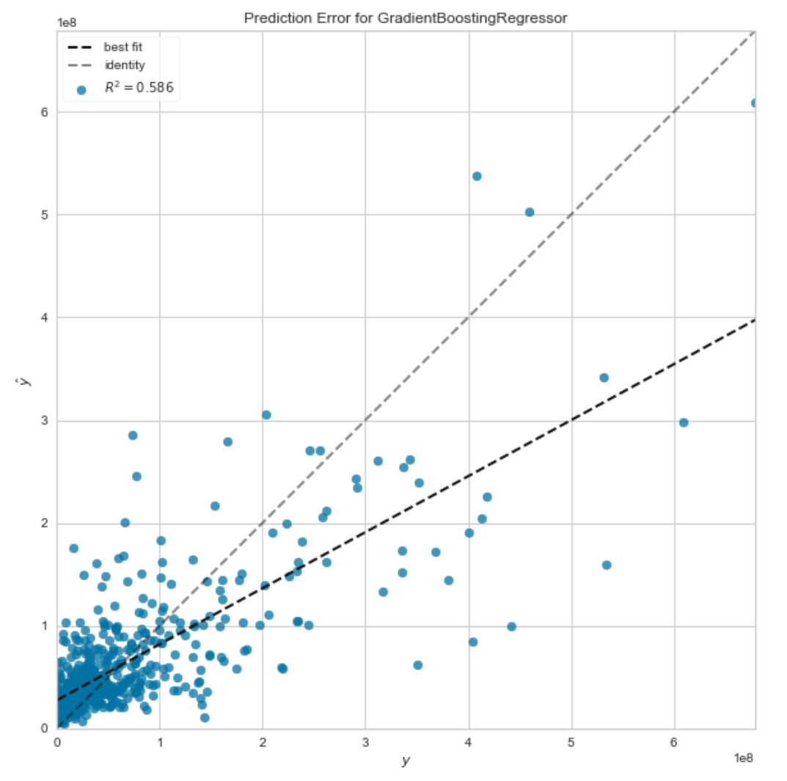
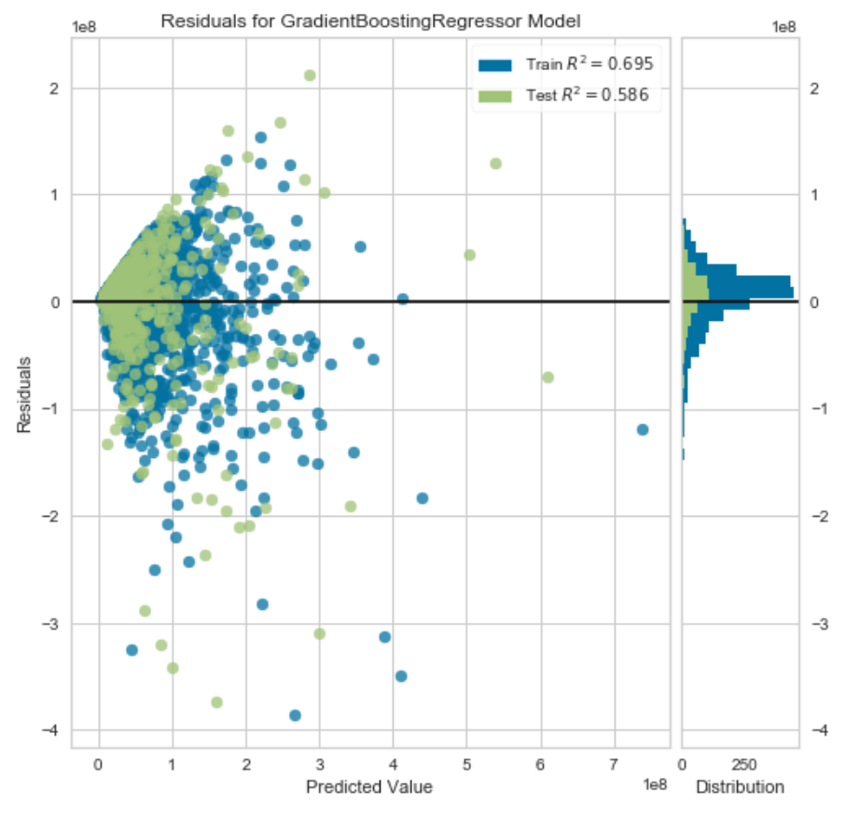
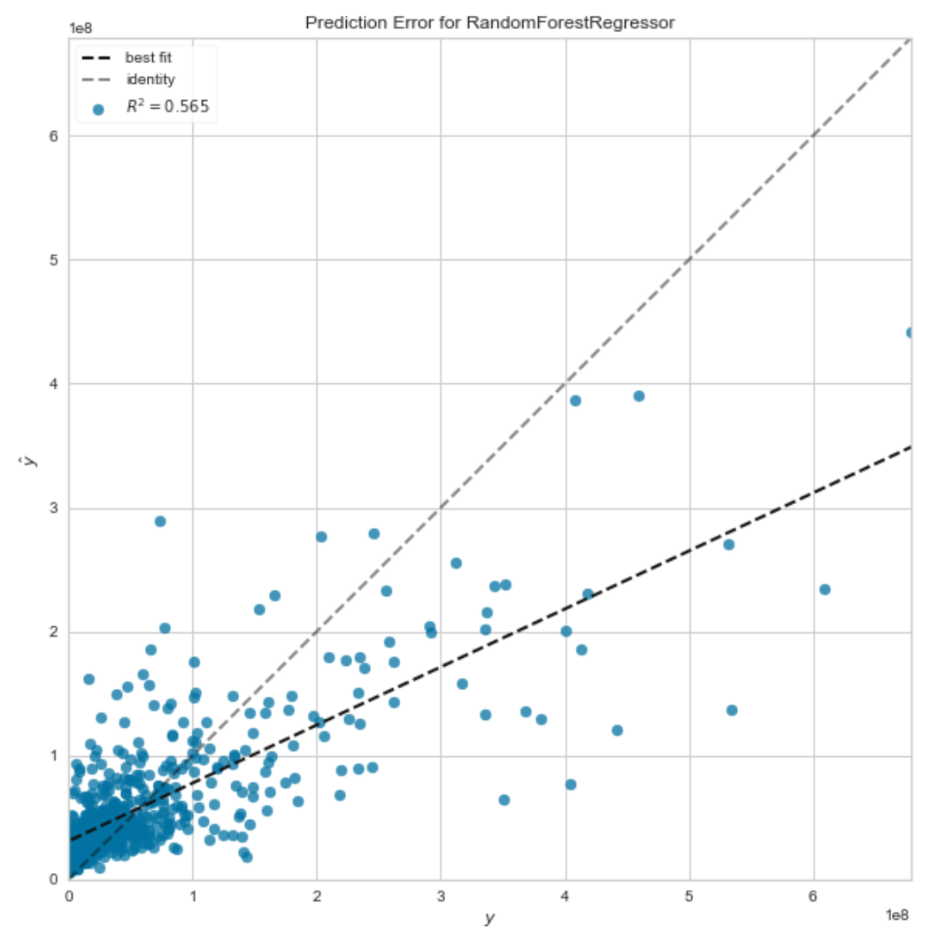
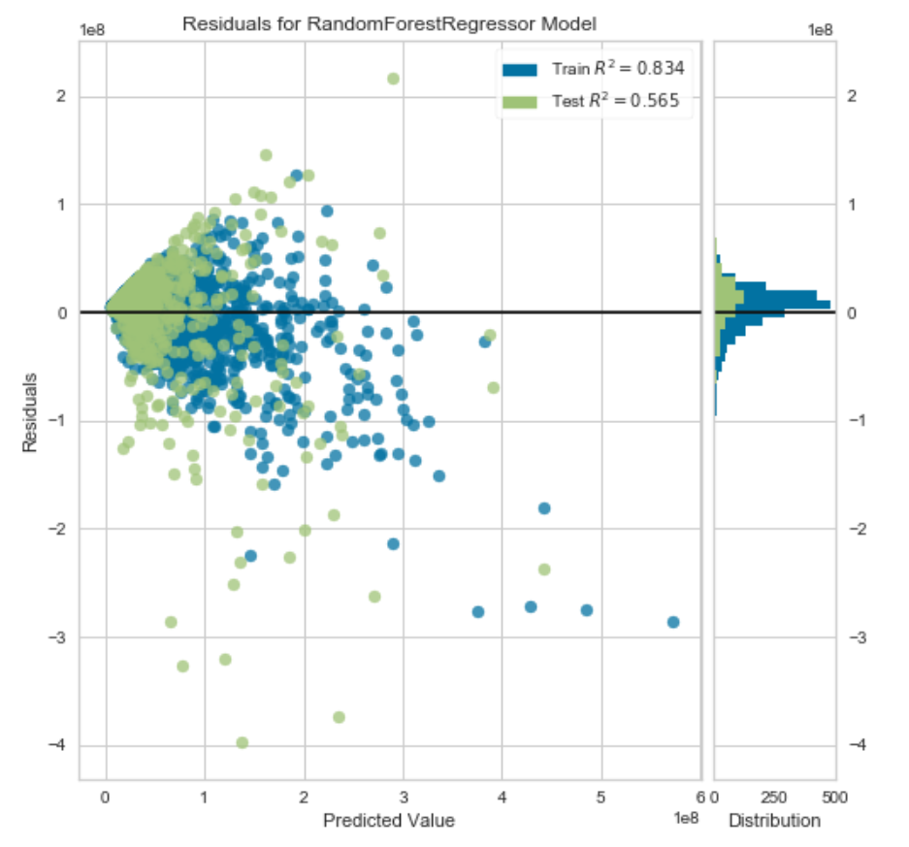
GradientBoostingRegressor
RandomForestRegressor
Final Models – Performance Comparison

Slide 42
Model Analysis - GBM

Slide 43
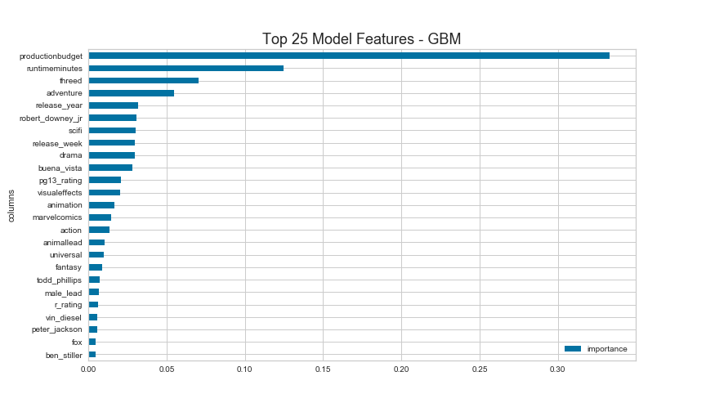
Feature Importance

Slide 44
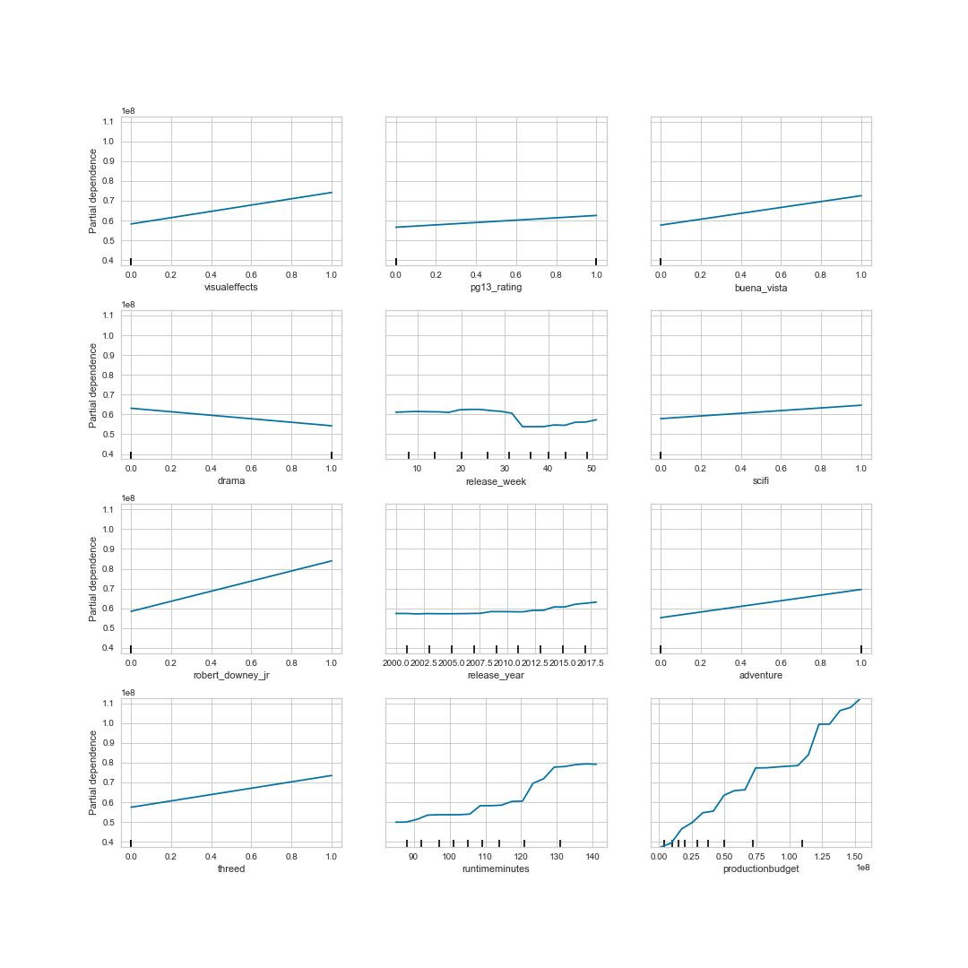
Partial Dependence Plots

Slide 45
Additional Feature Engineering
To address high-dimensionality, sparse actor/director/genre features, & represent prior sales performance, tested additional features:
Rolling 12 month average sales for primary genre
Average sales for prior films for the lead actor/actress
# prior films for lead actor/actress
Average sales for prior films by the director
# prior films by the director
Inclusion of these features improved model performance slightly to R^2 = .602
Complicates the implementation & interpretability of the model

Slide 46
Application and Opeartion
EC2
NGINX Webserver
Rest API Request
v
HTML
Convert Input into binary
JavaScript
Load joblib model
joblib
CSS
Predict using input data
Dump model into file.joblib

Slide 47
Limitations
Missing values for each feature
Finding datasets that had more information about key features, such as actors/actresses and directors

Slide 48
Real-time APP predition
http://ec2-34-238-50-190.compute-1.amazonaws.com/

Slide 49

Box Office Smash Team
Thank you!

Slide 50
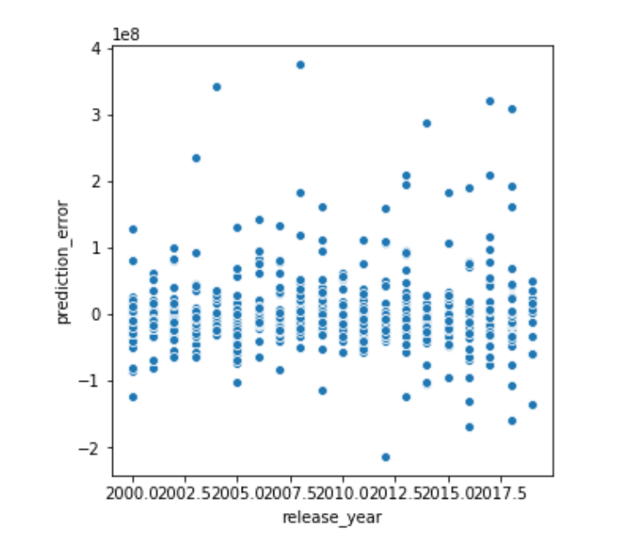
Inflation Adjustment?
Prediction Error by Release Year
Considered training model on inflation-adjusted data to account for change in dollar value over time, but:
Only using data back through 2000
Inclusion of release year feature helps mitigate the impact of the potential distortion
Prediction error not significantly biased by release year

